Slide 1


Emotion Detection System: A Research Exploration of AI and Machine Learning
Welcome to our research exploration of emotion detection systems, a field at the forefront of Artificial Intelligence and Machine Learning. This presentation delves into the science, applications, and potential of this innovative technology, examining its current state and future trajectory. Here we have use python programming language in google colab for making this project successful.
Notes:
1

Slide 2


Introduction to Emotion Detection
Definition
Core Concepts
Emotion detection, also known as sentiment analysis or affective computing, refers to the use of technology to identify, interpret, and understand human emotions.
Emotion detection systems rely on various techniques, including facial expression analysis, voice tone analysis, and text-based sentiment analysis, to interpret emotional states.
Importance
This field holds immense potential for revolutionizing human-computer interactions, enhancing user experiences, and enabling deeper understanding in various domains, such as healthcare, marketing, and education.
Notes:
2

Slide 3
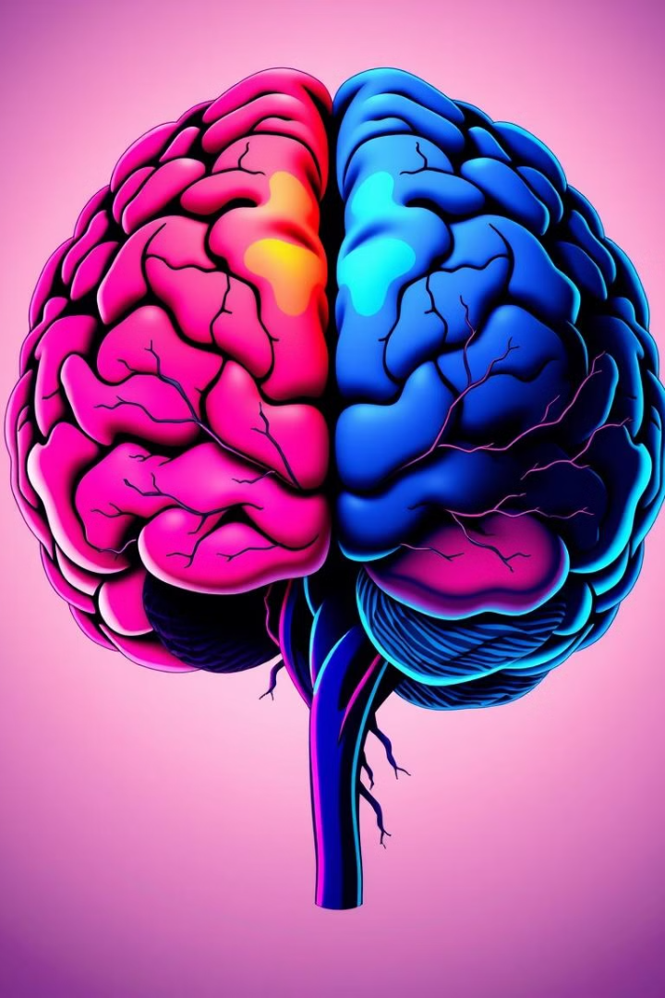
The Science behind Emotion Detection
1
Human Emotions
2
Machine Learning Algorithms
Understanding the complex interplay of human emotions is a fundamental aspect of emotion detection. Researchers have identified six basic emotions: happiness, sadness, anger, fear, surprise, and disgust.
Machine learning algorithms are central to emotion detection. These algorithms are trained on vast datasets of emotional data, allowing them to identify patterns and predict emotional states based on input signals.
3
Data Processing Techniques
Emotion detection systems utilize various data processing techniques, such as Natural Language Processing (NLP) for analyzing text, and computer vision for analyzing images and videos.
Notes:
3

Slide 4
Applications of Emotion Detection Technology
User Experience
Healthcare
Marketing and Advertising
Personalized recommendations
Mental health monitoring
Targeted advertising campaigns
Interactive gaming experiences
Patient-doctor interaction analysis
Customer sentiment analysis
Adaptive user interfaces
Drug efficacy assessment
Product design optimization
Notes:
4

Slide 5

Challenges and Limitations in Emotion Detection
Data Bias
1
Emotion detection systems can be biased if trained on datasets that do not adequately represent the diversity of human emotions and expressions.
2
Contextual Understanding
Understanding the context of an emotion is crucial for accurate interpretation, but current systems struggle to fully grasp the nuances of social and cultural context.
Privacy Concerns
3
The collection and analysis of emotional data raise significant privacy concerns, particularly in sensitive applications like healthcare and security.
Notes:
5

Slide 6
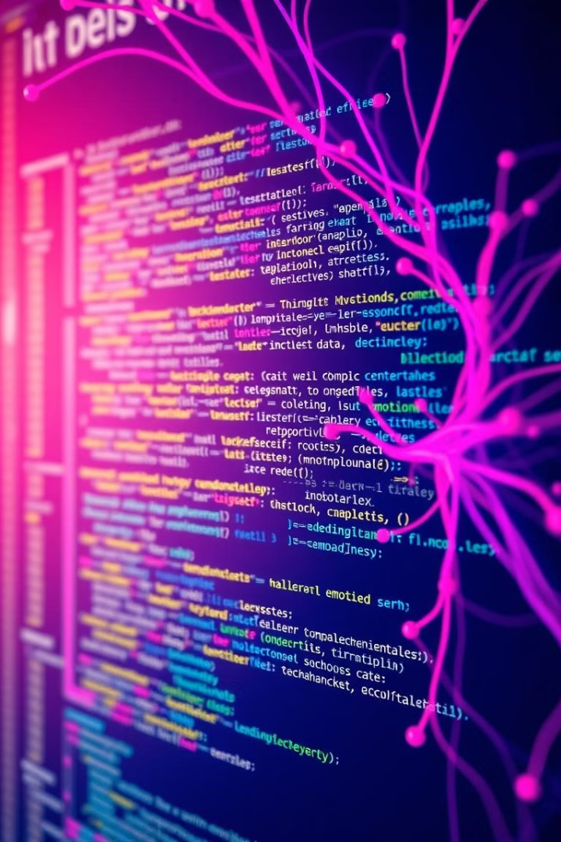
Coding Demonstration
This section is dedicated to a live coding demonstration, where we will explore key aspects of developing an emotion detection system using Python and relevant libraries. The demonstration will showcase how to train a machine learning model on a dataset of facial expressions and analyze the model's predictions.
Notes:
6

Slide 7
1. !pip install opencv-python-headless: Installs OpenCV for image processing without GUI support.
!pip install tensorflow: Installs TensorFlow for building and running deep learning models.
2. import cv2: Imports the OpenCV library for image and video processing.
import numpy as np: Imports NumPy for numerical operations, often used for handling image data.
from tensorflow.keras.models import load_model: Imports the function to load pre-trained models in Keras (part of TensorFlow).
from tensorflow.keras.preprocessing.image import img_to_array: Imports the function to convert images to arrays, which is useful for preparing images for neural network models.
from google.colab.patches import cv2_imshow: Imports the function to display images directly in Google Colab.
3. This code loads a pre-trained emotion detection model from the file emotion_detection_model.h5, making it ready for use
4. This code creates a list named emotion_labels that contains the names of the emotions the model can predict. These labels correspond to the predicted classes of the emotion detection model, and they are used to interpret the model's output.
5. This code captures a photo from your webcam using JavaScript, saves it as photo.jpg, and displays it using OpenCV in Google Colab.
6. This code reads an image, converts it to grayscale, detects faces using OpenCV, predicts the emotion of each detected face using a pre-trained model, and then displays the image with bounding boxes and emotion labels around the faces.

Slide 8
TensorFlow is an open-source platform for machine learning developed by Google. It's a comprehensive and flexible system that allows developers to build and deploy machine learning models with ease.
opencv-python-headlessopencv-python-headless is a version of the OpenCV library for Python that doesn't include any GUI dependencies. This makes it ideal for server environments, such as Docker containers or cloud environments, where you don't need to display images or use GUI elements.
Cv2 is a module in Python that allows you to use the OpenCV (Open Source Computer Vision Library) functionalities. OpenCV is an extensive open-source computer vision and machine learning library. It includes numerous algorithms and functions for tasks like image and video processing, object detection, and more.
NumPy is a fundamental package for scientific computing in Python. It provides support for large, multi-dimensional arrays and matrices, along with a collection of mathematical functions to operate on these arrays
tensorflow.keras.models is a module in TensorFlow's Keras API that provides a set of classes and functions to define and manage machine learning models
The tensorflow.keras.preprocessing.image module provides utilities for processing image data, which is essential for tasks such as data augmentation and normalization
google.colab.patches is a module in Google Colab that provides some useful patches and utilities to enhance your experience while working with Colab notebooks
IPython.display is a module in IPython that provides a variety of functions to display rich content in Jupyter notebooks. It's particularly useful for displaying images, audio, video, and more directly in the notebook interface.
google.colab.output is a module in Google Colab that provides utilities for controlling the output display in your notebook.
eval_jseval_js is a function in the google.colab.output module that allows you to execute JavaScript code within your Colab notebook. This can be particularly useful for creating interactive visualizations or other dynamic elements.

Slide 9
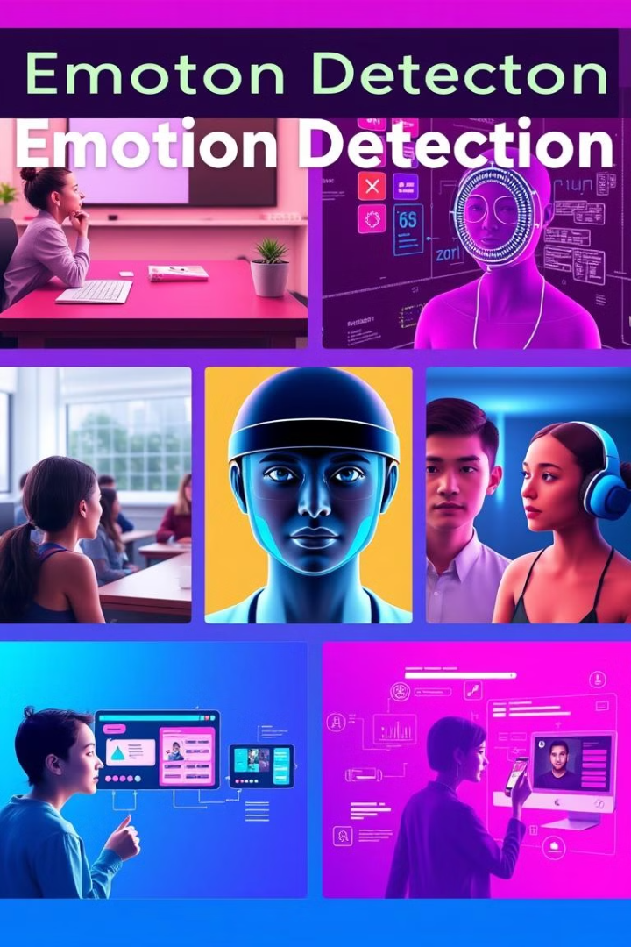

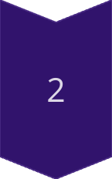
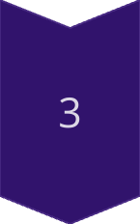
Emotion Detection Use Cases
Education
Real-time feedback on student understanding and engagement.
Security
Detecting suspicious behavior in public spaces.
Customer Service
Analyzing customer sentiment and providing personalized support.
Notes:
8

Slide 10
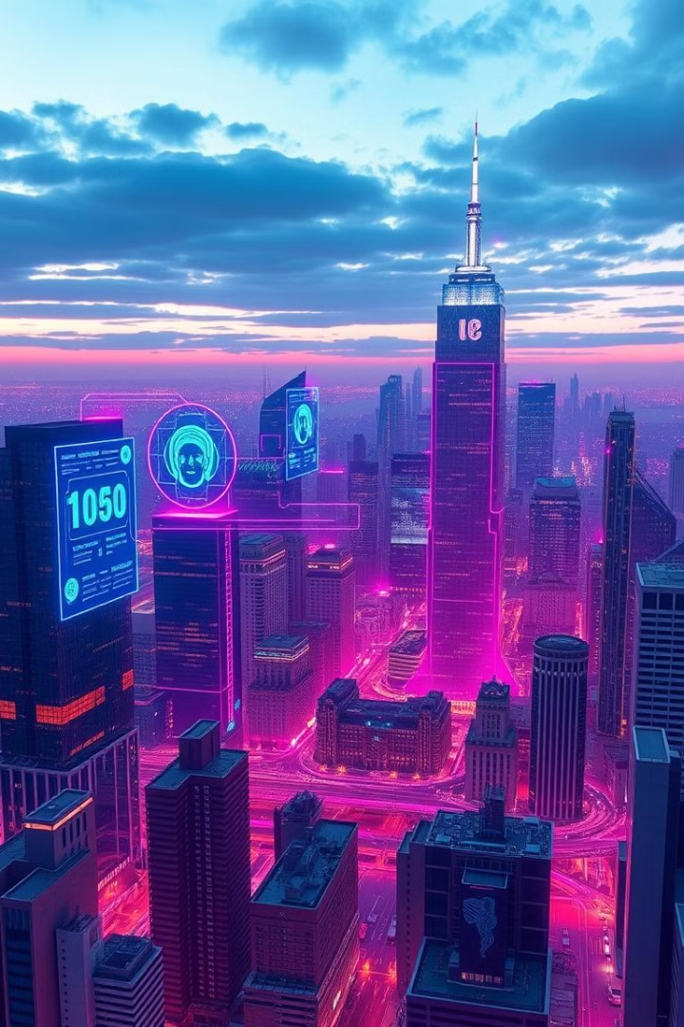



Future Trends in Emotion Detection
AI Advancements
Continued advancements in AI and deep learning will lead to more sophisticated emotion detection models with improved accuracy and contextual understanding.
Data Integration
Integration of multimodal data sources, including facial expressions, voice tone, and physiological signals, will enhance the holistic interpretation of emotions.
Ethical Considerations
Ethical concerns surrounding data privacy, bias, and responsible use will drive the development of guidelines and regulations for emotion detection technologies.
Notes:
9

Slide 11
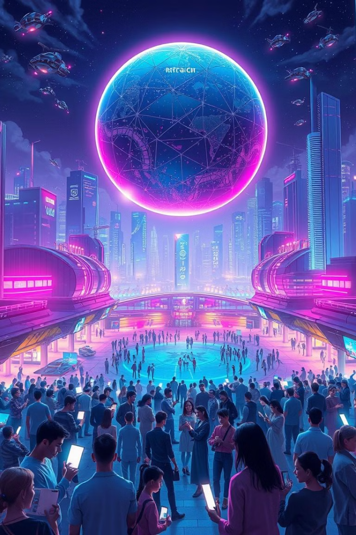
Conclusion and Key Takeaways
Emotion detection systems are revolutionizing the way we interact with technology, opening up new possibilities in various fields. While challenges remain, ongoing research and advancements in AI are paving the way for more accurate, ethical, and impactful applications. As we move forward, it's crucial to consider the ethical implications and ensure responsible deployment of this powerful technology.
Notes:
11

Slide 12
Where Did We Get This Idea To Make This Project On This Particular Topic?
Notes:
12

Slide 13
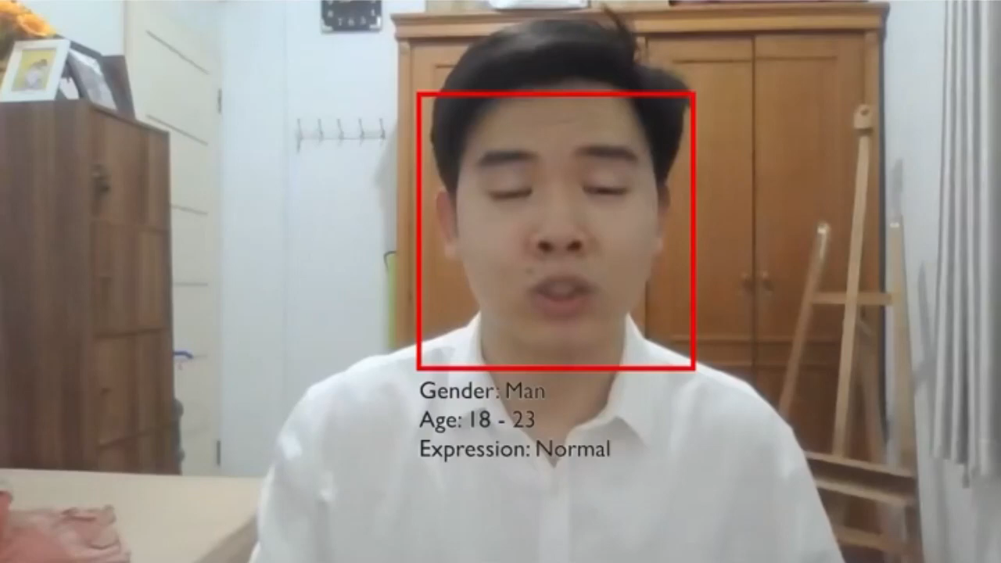
Notes:
13

Slide 14

Bhoooooooooooooooooot!!💀 💀 💀 💀 💀

Slide 15
Ok, Then

Slide 16
Any
Doubts
Notes:
Do
16

Slide 17
Thank You!!
Notes:
18

